Slide 1
Twelfth Night or What You Will
By William Shakespeare

Slide 2
Journal
Respond to the following prompts. Do you agree or disagree? Why?
Honesty is always the best policy.
Love that is not returned cannot be earned.
Social class has a say in who one can love.

Slide 3
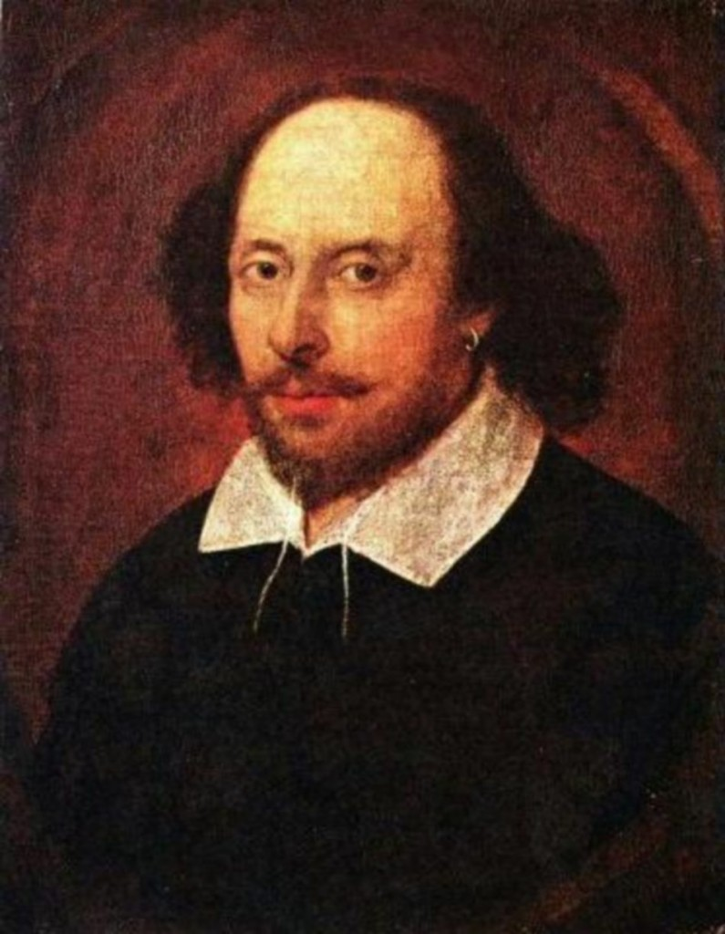
William Shakespeare 1564-1616
Writer during the Elizabethan and Jacobean ages of British theatre (sometimes called the English Renaissance or the Early Modern Period).
Shakespeare's work includes 38 plays, 2 narrative poems, 154 sonnets, and a variety of other poems.
No original manuscripts exist today
This Photo by Unknown Author is licensed under CC BY-SA-NC

Slide 4
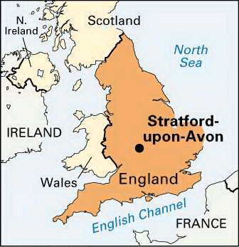
William Shakespeare
Stratford-upon-Avon
This Photo by Unknown Author is licensed under CC BY-NC-ND

Slide 5
William Shakespeare
One of eight children
John Shakespeare and Mary Arden
First surviving child: 3 born before him
Father’s elevated status allowed William to receive grammar school education
Secondary education; based on ability
Married Anne Hathaway and had 3 children

Slide 6
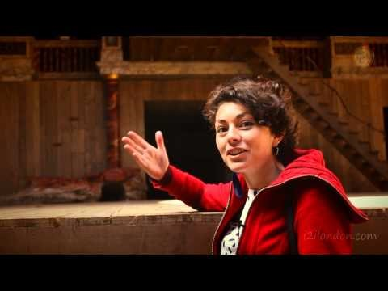
The Globe Theater

Slide 7
Drama
Drama is an art form that allows us to be spectator/participators in a story.
Makes powerful comments on human nature and the human condition
Reveals human truth arising out of characters under pressure of situation
It is a persuasive and memorable mode of conveying truth
Visual, auditory, and spoken.
Tragedy is the branch of drama that treats in a serious style the sorrowful events experienced, encountered, or caused by a heroic individual.
Originated from the Greeks and derived from Homer’s works.
Comedy is the branch of drama meant to be amusing and entertaining
Happy endings
Imitation of the ridiculous
This Photo by Unknown Author is licensed under CC BY-SA

Slide 8
Literary Terms
Conflict: main problem that drives the plot and fuels the action.
Suspense: building of tension
Monologues: single person speaking to the other characters on stage or the audience. It's a dramatic speech that gives us access to the character's thoughts—or at least the ones they're willing to reveal to us.
Soliloquies: monologue given by a character in a play who is alone on the stage
Usually reveals key thoughts, feelings, and opinions to the audience
Asides: when a character's dialogue is spoken but not heard by the other actors on the stage
Useful for giving the audience special information about the other characters onstage or the action of the plot.
Farce: comic dramatic piece that uses highly improbable situations, stereotyped characters, extravagant exaggeration, and violent horseplay.
Satire: a genre that strives to improve bad behavior through sarcasm and irony.
Making fun of foolishness so that the subject can improve

Slide 9
Characterization
Protagonist: main character, “good guy”
Antagonist: group/person who stands against the protagonist, “bad guy”
Foil: a character whose main purpose is to offer a contrast to another character, usually the protagonist.
Foils set off and accentuate the main character and are convenient ways to complicate and deepen the characterization of the protagonist.
The foil's differences highlight the key qualities of the main character.

Slide 10
Shakespearean Characterization
Stock Character: stereotypical, one-dimensional
Predictable
Provide comic relief, cast a menacing presence, deliver news vital to the plot
Fool: clever peasants/commoners that use their wit to “outdo” people of higher social status
Often speak truth to the other characters and the audience
Cross Dressing: common technique on comedies to progress the plot
Gives the female character more freedom in a restrictive society for women
The female character dressed as a man can move more freely, speak more freely and use their wit and intelligence to overcome problems.

Slide 11
Context of the Play
The play’s title Twelfth Night takes its name from an English holiday celebrated on January 5th
The Twelfth Night of Christmas
Playing jokes and acting out plays
Merriment and festivities
“Feast of Misrule”
Kings and nobles treated as peasants and vice versa
The second title, What You Will, references the disorder and revelry of the holiday

Slide 12
Act II Discussion Questions
Is the deception and disguise used in the play justified? Why or why not?
How does Viola show her wit, while dressed as Cesario in the scene where Malvolio returns the ring? What does this interaction reveal about Malvolio?
What realization does Viola come to regarding her current predicament?
What is Malvolio’s main motivation in his life? Why does he want to be with Olivia?
How does Maria create a play-within-a-play?
How does Maria’s letter mock Orsino?
How does Feste’s song mock Orsino?
How has melancholy started to produce madness within the characters?

Slide 13
Act III Discussion Questions
What are the complications that arise because of disguise, mistaken identity, or trickery?
Is Malvolio more ridiculous than Olivia and Duke Orsino? Why or why not?
Why do you think Sir Toby deceives his friend, Sir Andrew?
How would you compare Olivia’s love to Orsino’s love? Is it the same or different?
Where does Sir Toby seem to best fit in with the characters? High or low class? Why do you think Shakespeare has done this?
What is the connection between madness and love in this play?

Slide 14
Act IV Discussion Questions
Explain the meeting between Andrew and Cesario.
Thinking Sebastian is Cesario, what does Olivia ask of him?
What do Maria and Feste plan for Malvolio? What is Malvolio’s reaction?
What does Malvolio convince Feste to do?
Does Toby have a change of heart? Why?
Why is Sebastian puzzled?
How does Act IV end?

