Slide 1
Thesis Statements 101
Literary Analysis

Slide 2
What is a thesis statement?
A declaration of the purpose of your essay.
THE MAIN IDEA!!!
Tells the reader where you’re going in the following paragraphs.
A stance you take on a prompt.
Offers perspective and interpretation of the subject.

Slide 3
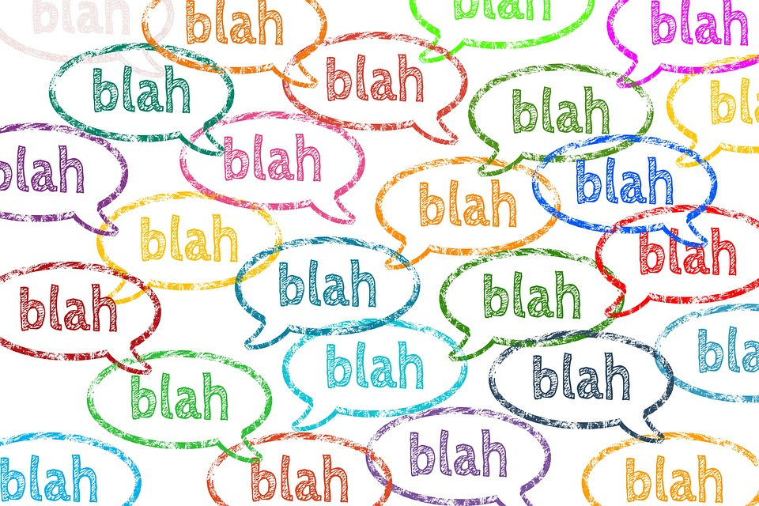
What is NOT a thesis statement?
A question.
A hook.
The topic sentence of your introduction.
Background information.

Slide 4
NOT Thesis Statements (aka Mrs. Bossert’s pet peeves)
I am going to tell you the theme of my essay.
I am going to talk about the main character of the novel.
The character changed.
What is the theme of my essay, you might ask? Well, I’m going to tell you.
How are John and Jack similar and different?
Have you ever thought about the theme of this book?

Slide 5
Questions to ask yourself:
Did I answer the prompt?
Is my thesis specific?
Will my reader be prepared for what they’re about to read?
Does it give an outline for the body paragraphs?
So what?

Slide 6
The 3-Prong Thesis
When you are writing a 5 paragraph essay, it is helpful to write 3 reasons (or prongs) that explain your stance/idea. This will help guide you as you decide on topics for your body paragraphs.

Slide 7
EXAMPLE - THEME
In The Hunger Games, Suzanne Collins explores how sacrifice shows the importance of human life.
In The Hunger Games, Suzanne Collins explores how sacrifice shows the importance of human life through Katniss’ sacrifices for Prim, Peeta, and the sacrifice of her own life.
What makes the second thesis statement stronger than the first?

Slide 8
Why is the 3-prong stronger?
Now you have topic sentences for your body paragraphs!
How Katniss’ sacrifice for Prim shows the importance of human life.
How Katinss’ sacrifice for Peeta shows the importance of human life.
How her willingness to sacrifice her own life shows the importance of others’ lives.

Slide 9
EXAMPLE - CHARACTER DEVELOPMENT
The character Hamlet, in William Shakespeare’s Hamlet, changes dramatically throughout the play.
The character Hamlet, in William Shakespeare’s Hamlet, changes dramatically throughout the play as his antic disposition becomes reality. In the beginning, Hamlet appears to be acting mad. Later, he demonstrates that his act is starting to become his reality. By the end, Hamlet’s act of madness is no longer antic disposition.
How would you set up the body paragraphs?

Slide 10
EXAMPLE - COMPARE/CONTRAST
In The Great Gatsby by F. Scott Fitzgerald, Tom and Gatsby are more similar than they appear on the surface.
In The Great Gatsby by F. Scott Fitzgerald, Tom and Gatsby are more similar than they appear on the surface. Despite the fact that Tom Buchanan and Jay Gatsby gain their wealth from different sources, these characters are similar in their lack of honest hard work, selfish pursuit of materialism, and objectification of women.

Slide 11
TIPS & TRICKS
Here’s some things to keep in mind when writing an effective thesis statement:
NEVER say “I think…” ; “I believe…” ; “My essay is going to be about…” ; etc.
I know who the author is. I know that you wrote it.
Do not use a direct quote.
Use clear and specific language.
Never assume that what you’re trying to say is obvious!
Use active verbs.
Try to keep it in 1-2 sentences.
Always ask yourself “SO WHAT?”

