Slide 1
“The Bet”
Anton chekhov

Slide 2
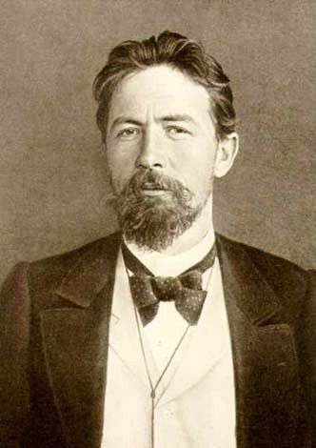
Anton Chekhov
Russian playwright and father of the modern short story
Grew up in an impoverished home
Full-time practicing doctor AND writer
Known for being objective in his writing
Lack of complex plot and neat resolutions
This Photo by Unknown Author is licensed under CC BY-SA

Slide 3
Journal
In your spiral notebook, respond to the following statements and explain why you agree or disagree with each statement.
There are things in the world that are more valuable than money.
Money can buy happiness

Slide 4
Discussion questions
Why do you think the lawyer took the bet? What does this reveal about him?
Why do you think the lawyer is so motivated to study different subjects?
Why does the banker call the bet “cursed”?
The lawyer writes that he has experienced all kinds of things in books: love, hunting, mountain climbing, storms, miracles, religions, wars, etc. Is reading about something the same as experiencing it? Which is better and why?
How much can one live vicariously through books? (vicariously = felt or enjoyed through imagined participation in the experience of another)

Slide 5
Discussion questions
The lawyer once saw the two millions as "paradise," but now he despises the money. Why?
Why does the banker have contempt for himself after reading the lawyer's letter?
How are each of these men different after 15 years?
In the context of the short story, how are both the banker and the lawyer corrupted by greed?
In your opinion, can money buy happiness? Why or why not? What is the connection between happiness and money?

Slide 6
Resources used
https://www.shmoop.com/bet-chekhov/
https://www.britannica.com/biography/Anton-Chekhov
https://www.thoughtco.com/anton-chekhov-2713624
http://www.barren.k12.ky.us/userfiles/12141/Classes/91869/thebetdiscussionquestions.pdf?id=80174

