Slide 1
The Strange Case of Dr. Jekyll and Mr. Hyde
By Robert Louis Stevenson

Slide 2
What do you think?

Slide 3
Are there degrees of evil?

Slide 4
Are all people capable of doing evil? Do all people commit evil acts?

Slide 5
Can there be good without evil?

Slide 6
Who determines what is evil?

Slide 7
Can evil be done unconsciously? Is an act evil if the person committing it is not aware that it is an evil act?

Slide 8
Context of the Novel

Slide 9
Historical Context
Victorian Era
1830s-beginning of 1900s
Queen Victoria came to the throne in 1837 at the age of 18
Ruled until her death in 1901 (64 year reign)
During Victorian Era, Great Britain was the world’s leading economic and military power – controlled a vast empire
Transportation and communication became faster with railroad and postal system
Advances in health
Government began to financially support schools
Agriculture became less important to the economy
Prosperous decades: 1850-70
Urban population increase = poverty (1880s)
Workers began to demand more power and women were entering the workforce
Changes in traditional society frightened and disturbed Britons

Slide 10
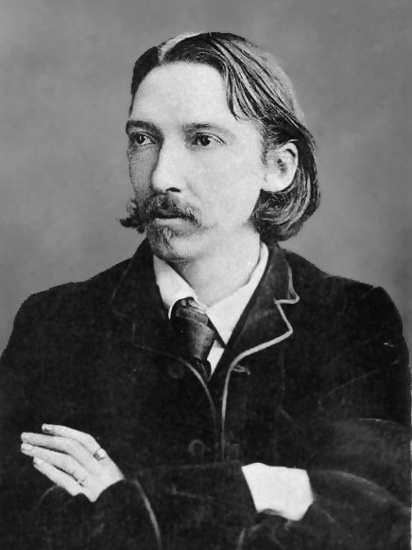
Robert Louis Stevenson
Born in 1850: Edinburgh, Scotland
Sickly child
Studied literature @ Edinburgh Uni
Spent time in French Riviera and Southern England because warmer climates were good for health
Wrote first book due to travels in France
Met and fell in love with an American – Fanny Osbourne (who was already married)
Took a risky trip to California that nearly killed him
Married Fanny after she divorced her husband

Slide 11
Robert louis stevenson
Returned to Scotland and wrote his first great success, Treasure Island (1883)
Dr. Jekyll and Mr. Hyde is based on one of Stevenson’s nightmares
Critics compare Stevenson to Poe and Hawthorne
The novel perfectly captures readers’ fears that their carefully built society was hypocritical
Some saw it is a symbolic representation of threats to traditional British society
Karl Marx’s ideas were becoming more influential
Darwin and Social Darwinism
Survival of the fittest
Freud – human beings are powerfully influenced by impulses
Stevenson may have been rebelling against his strict religious upbringing
Interested in the conflict between science and religion

Slide 12
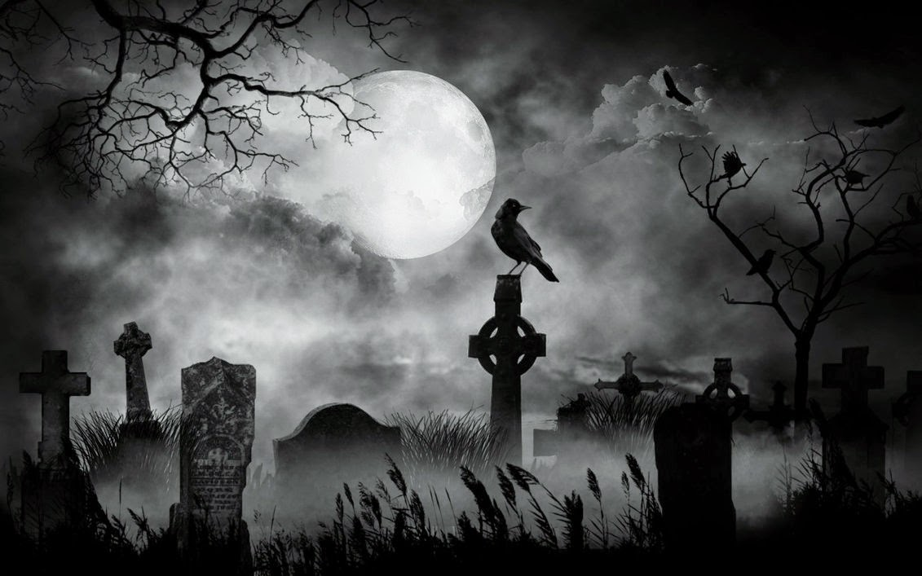
Gothic Literature
Genre in which the author emphases the grotqesque, the mysterious, the horrible, and the fearful.
Setting of most horror stories
Gives the reader a sense of the ghostly supernatural world
Played on the fears and anxieties of the Victorians

Slide 13
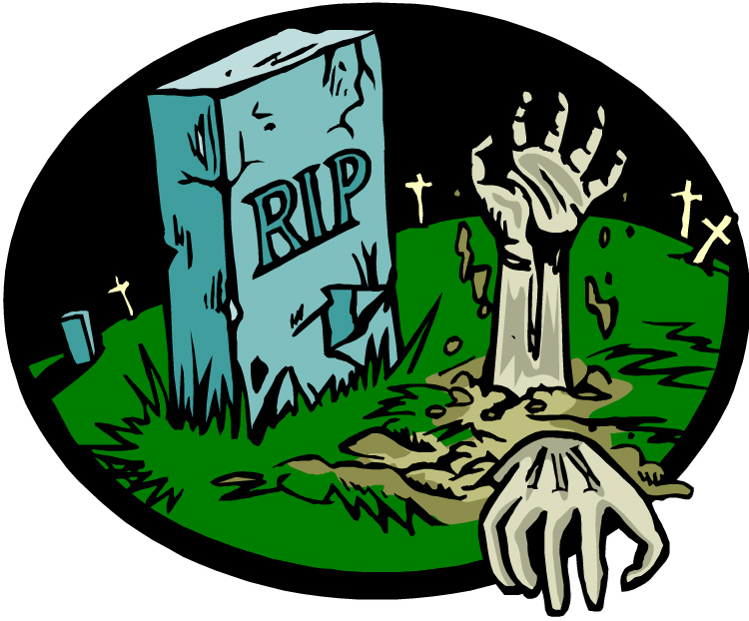
Common elements of Gothic Literature
Remote, unknown but familiar location
Emphasis of physical things to promote an eerie and ghostly atmosphere
Characters are emotionally sensitive but maladjusted (disturbed) in appearance
Creatures possess some sort of psychic communication
Possibility of returning to life after one is dead

Slide 14
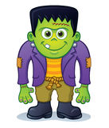
Important british Gothic Writers
Mary Shelley
Frankenstein
Percy Byshe Shelley
William Wordsworth
Lord Byron
Robert Louis Stevenson

Slide 15
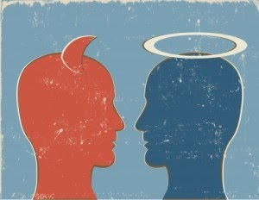
Definitions
DUALISM: a thought about the facts of the world in general or of a particular class cannot be explained except by supposing ultimately the existence of two different, often opposite, and irreducible principles.
DOPPELGANGER: the idea that all humans have an exact double. If you meet your doppelganger, you die!
BINARY OPPOSITIONS: the theory that we can only understand one concept by having experience of its opposite.

Slide 16
Freud
Psychodynamic Concepts: humans were neither exclusively or essentially good.
“Structural Theory”
ID THEORY:
Seeking instant gratification
Aggressive instinct
No moral or social value
Taking pleasure in violence
EGO THEORY:
Conscious and rational
Dominated by Social Principles
SUPEREGO THEORY:
Victorian Society – prided itself on refinement and goodness

