Slide 1
“Dulce et Decorum Est”
By Wilfred Owen

Slide 2
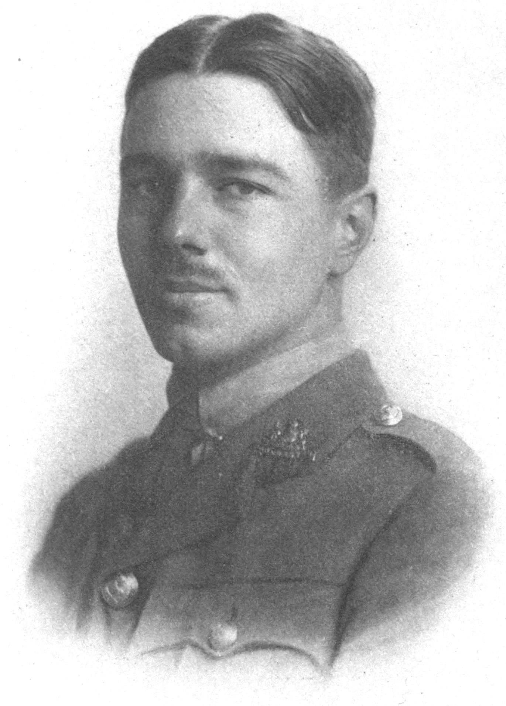
Who is Wilfred Owen?
British poet
Enlisted in the army in 1915
In November 1918, he was killed while attempting to lead his men across the Sambre canal at Ors.
He wrote “Dulce et Decorum Est” in January 1917 while in France to his mother

Slide 3
World War I
World War 1 began on July 28, 1914. The conflict lasted four years, three months and 14 days, ending on November 11, 1918.
Chemical weapons were first used in WW1. Using poison gas was considered a war crime, but tear gas wasn’t considered to be a conflict by the troops.
The Germans were the first to use lethal gases when they used a chlorine gas attack.
Later they also developed and used the most effective gas of the First World War — mustard gas. The British were shocked at the German use of poison gas, but developed their own gas warfare to retaliate.
WW1 officially ended on June 28, 1919.
Notes:
Tear gas causes irritation to the eyes – used to disperse crowds

Slide 4
Dulce et Decorum Est
“It is proper and sweet to die for the fatherland”
Allusion to Roman lyrical poet, Horace’s Ode (III.2.13)
Allusion: An allusion is more than simply copying from another work: it is a conscious reference that invites critical engagement with another work that the reader is assumed to have read.
Thought to be part of propaganda
Call to Youth
Owen considers Horace’s ode the “old Lie”
Response to Jesse Pope poems that were a call for men to enlist in the war effort

