Slide 1
Introduction to Poetry
Types of poetry & figurative language

Slide 2
Stanza
A grouping of lines separated from others in a poem. In modern free verse, the stanza, like a prose paragraph, can be used to mark a shift in mood, time, or thought.

Slide 3
Meter
The stressed and unstressed syllables within the lines of a poem
The stressed syllables are longer while the unstressed syllables are shorter
Gives the poem a melodious sound

Slide 4
Twelfth Night
“If music be the food of love, play on; Give me excess of it, that, surfeiting, The appetite may sicken, and so die. That strain again! it had a dying fall: O, it came o’er my ear like the sweet sound, That breathes upon a bank of violets …”

Slide 5
Iamb
Short syllable followed by a long syllable
Metrical foot
​Iambic dimeter (2 iambs per line/4 syllables)
Iambic trimeter (3 iambs per line/6 syllables)
Iambic tetrameter
Iambic pentameter
​Iambic hexameter

Slide 6
“The Only News I Know” - Emily Dickinson
“The only news I know Is bulletins all day From Immortality. The only shows I see, Tomorrow and Today, Perchance Eternity.”

Slide 7
Couplet
Two rhyming lines in a verse
Same meter​​
​Can be an independent poem or part of other poetry (Shakespeare sonnets)
If this be error and upon me proved, I never writ, nor no man ever loved.

Slide 8
Rhyme Scheme
The pattern of rhyme at the end of a verse.

Slide 9
End Rhyme
Most common type of rhyme used in poetry
Rhymes only when spelled, not always when it is pronounced
Through and Rough
Rhymes final syllables of a line

Slide 10
Internal Rhyme
Rhyme within a single line of a verse
Word from the middle of the line rhymes with the word at the end of the line
“Once upon a midnight dreary, while I pondered, weak and weary,”

Slide 11
Slant Rhyme
Half or Imperfect Rhyme
Stressed syllables of end consonants match
Vowels do not match
Poets use to create an inharmonious sound
Avoid “sing-song” effect
Creative freedom
Shape and keep
Moon and run
Hold and bald

Slide 12
Eye Rhyme
Similarity in spelling but not in pronunciation
Look alike but don’t sound alike Slaughter and Laughter Blood and mood Comb and Womb

Slide 13
Refrains
A refrain is a verse or phrase that is repeated at intervals throughout a song or poem, usually after the chorus or stanza.

Slide 14
Ballad
A popular narrative song passed down orally.
In the English tradition, it usually follows a form of rhymed (abcb) quatrains alternating four-stress and three-stress lines.
Folk (or traditional) ballads are anonymous and recount tragic, comic, or heroic stories with emphasis on a central dramatic event
Example: “Annabel Lee” - Edgar Allan Poe

Slide 15
Sonnet
A 14-line poem with a variable rhyme scheme originating in Italy.
Petrarchan sonnet
Eight-line stanza (octave) rhyming ABBAABBA
Six-line stanza (sestet) rhyming CDCDCD or CDEEDE.
“How Do I Love Thee” - Elizabeth Barrett Browning
The Italian sonnet
The octave’s rhyme scheme is the same as Petrach’s, but the sestet rhymes CDDCEE.
English (or Shakespearean) sonnet
One stanza of three quatrains and a concluding couplet
ABABCDCDEFEFGG

Slide 16
Sonnet 18
Shall I compare thee to a summer’s day? Thou art more lovely and more temperate: Rough winds do shake the darling buds of May, And summer’s lease hath all too short a date; Sometime too hot the eye of heaven shines, And often is his gold complexion dimm'd; And every fair from fair sometime declines, By chance or nature’s changing course untrimm'd; But thy eternal summer shall not fade, Nor lose possession of that fair thou ow’st; Nor shall death brag thou wander’st in his shade, When in eternal lines to time thou grow’st: So long as men can breathe or eyes can see, So long lives this, and this gives life to thee.

Slide 17
Lyric
Originally a composition meant for musical accompaniment. A short poem in which the poet, the poet’s persona, or another speaker expresses personal feelings.

Slide 18
Narrative
Beowulf The Odyssey Dante’s Inferno The Raven Paul Revere’s Ride The Charge of the Light Brigade
Tells a story in verse form
Relatively long for a poem
Plot, characters, setting, theme, dialogue
Contains poetic devices
Oldest form of literature

Slide 19
Limerick
Light hearted
5 lines
Rhyme scheme: AABBA
There was an Old Man with a beard, Who said, "It is just as I feared!— Two Owls and a Hen, four Larks and a Wren, Have all built their nests in my beard.

Slide 20
Haiku
A Japanese verse form
Three unrhymed lines of five, seven, and five syllables.
Image meant to depict a specific moment in time.
Basho, Buson, Issa
“Moras” in Japanese not directly translated to syllables in English

Slide 21
Free Verse
NO meter NO rhyme scheme NO set pattern
so much depends upon a red wheel barrow...

Slide 22
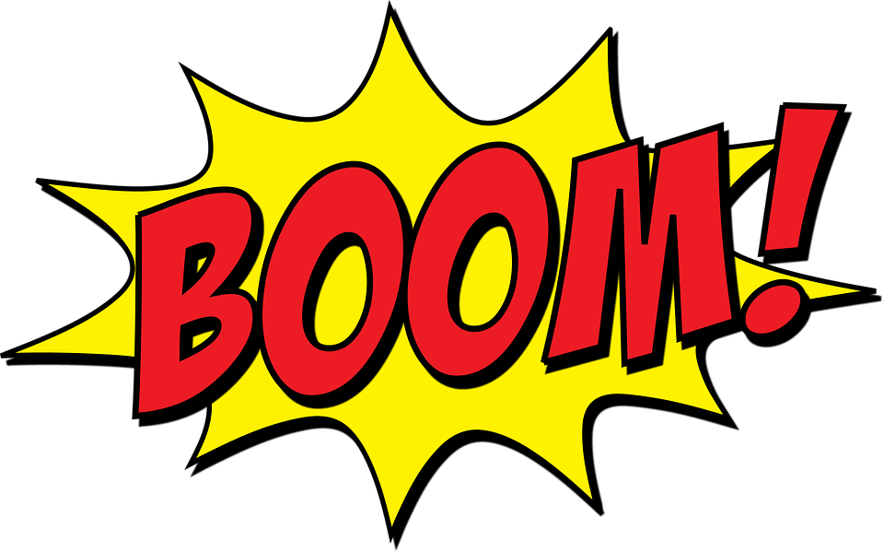
Onomatopoeia
A figure of speech in which the sound of a word imitates its sense

Slide 23
Alliteration
The repetition of initial stressed, consonant sounds in a series of words within a phrase or verse line
Peter Piper picked a peck of peppers

Slide 24
Assonance
When two or more words, close to one another repeat the same vowel sound, but start with different consonant sounds.
We light fire on the mountain.
Go and mow the lawn.
“He gives his harness bells a shake
To ask if there is some mistake.
The only other sound’s the sweep
Of easy wind and downy flake.
The woods are lovely, dark and deep.
But I have promises to keep,
And miles to go before I sleep,
And miles to go before I sleep.”
-”Stopping by Woods on a Snowy Evening” by Robert Frost

Slide 25
Simile
A figure of speech that makes a comparison, showing similarities between two things.
Uses the words “like” or “as” to draw resemblance.
“Wise as an owl”
“Cute as a kitten”
“Strong as an ox”

Slide 26
Metaphor
A figure of speech in which a word or phrase is applied to an object or action to which it is not literally applicable.
“The snow is a white blanket.”

Slide 27
Extended Metaphor
A comparison between two unlike things that continues throughout a series of sentences in a paragraph or lines in a poem.
Also known as a “conceit”

Slide 28
Mixed Metaphor
A figure of speech combining inconsistent or incongruous metaphor.
“Let's cross that bridge when we come to it” meaning let's put off the decision +
“Don't burn your bridges” meaning don't destroy a something you'll need later =
“We'll burn that bridge when we come to it,” meaning we're ready to fight when the right time comes.

Slide 29
Imagery
To use figurative language to represent objects, actions, and ideas in such a way that it appeals to our physical senses.
Associated with mental pictures
Needs the aid of figures of speech like simile, metaphor, personification, and onomatopoeia, in order to appeal to the bodily senses
“I wandered lonely as a cloud That floats on high o’er vales and hills, When all at once I saw a crowd, A host, of golden daffodils; Beside the lake, beneath the trees, Fluttering and dancing in the breeze.”

Slide 30
Symbol
A figure of speech where an object, person, or situation has another meaning other than its literal meaning.
Have a deeper meaning in the context of the whole story or poem.
Used to enhance a theme, idea, or a character.

Slide 31
Personification
A figure of speech in which a thing, idea, or animal is given human attributes.
Portrayed in such a way that we feel they have the ability to act like human beings.
“The stars danced playfully in the moonlit sky.”
“My alarm clock yells at me every morning.”

Slide 32
Allusion
Allusion is a brief and indirect reference to a person, place, thing or idea of historical, cultural, literary or political significance.
It does not describe in detail the person or thing to which it refers.
It is just a passing comment and the writer expects the reader to possess enough knowledge to spot the allusion and grasp its importance in a text.

